Slide 1

FINNISH HEALTH DATA HACKATHON
Care Plan & Clinical Reasoning Track
December 18, 2025
Notes:
Remember the recording!

Slide 2







Slide 3

AGENDA
Overview of the scope
Example topics
Your ideas for topics
Q&A
fhir.fi/hackathon

Slide 4


fhir.fi/hackathon
Notes:
This event is part of a larger series of hackathons

Slide 5

HL7 Finland 30 Years Symposium
Monday, 19 January 2026
Same premises as the hackathon
Requires different registration!
Draft agenda:
9.30-10.00 Coffee 10.00-12.00 Finnish sessions 12.00-13.00 Lunch 13.00-16.00 International sessions 16.00- Networking and drinks
www.hl7.fi/kokoukset-ja-tapahtumat/hl7-finland-30th-anniversary-symposium/

Slide 6
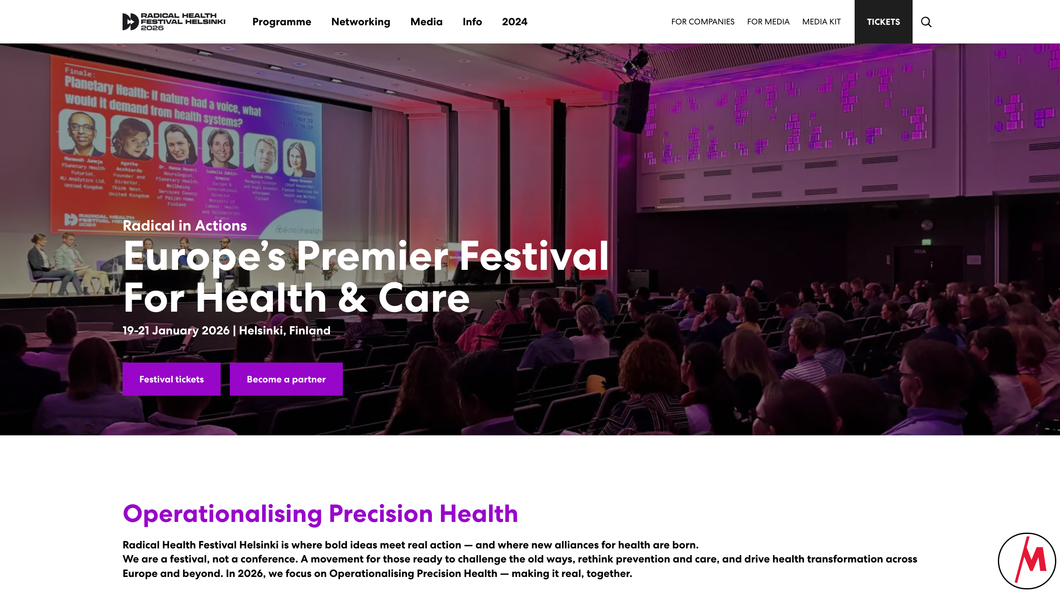

radicalhealthfest.com

Slide 7
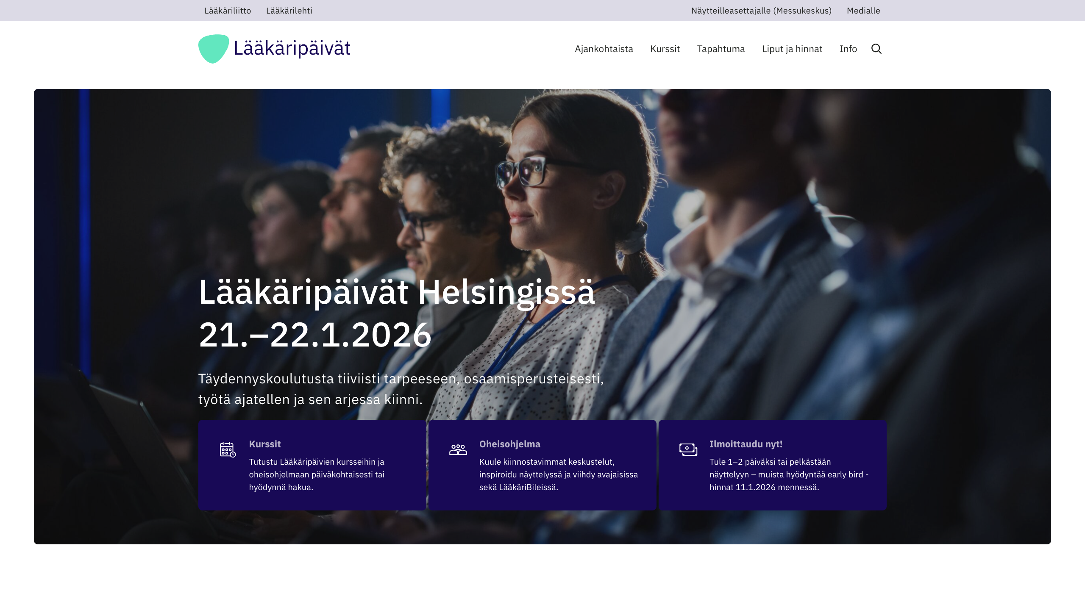

laakaripaivat.fi

Slide 8
When & Where
Monday, January 19, 2026, starting at 9:00 EEST
Some tracks continue on Tuesday, January 20, 2026
Results presented on Wednesday, January 21, 2026

Slide 9
Participation
Register in advance
No costs involved!
Notes:
for the main hackathon on Monday
Radical Health Festival and Lääkäripäivät require a paid registration

Slide 10
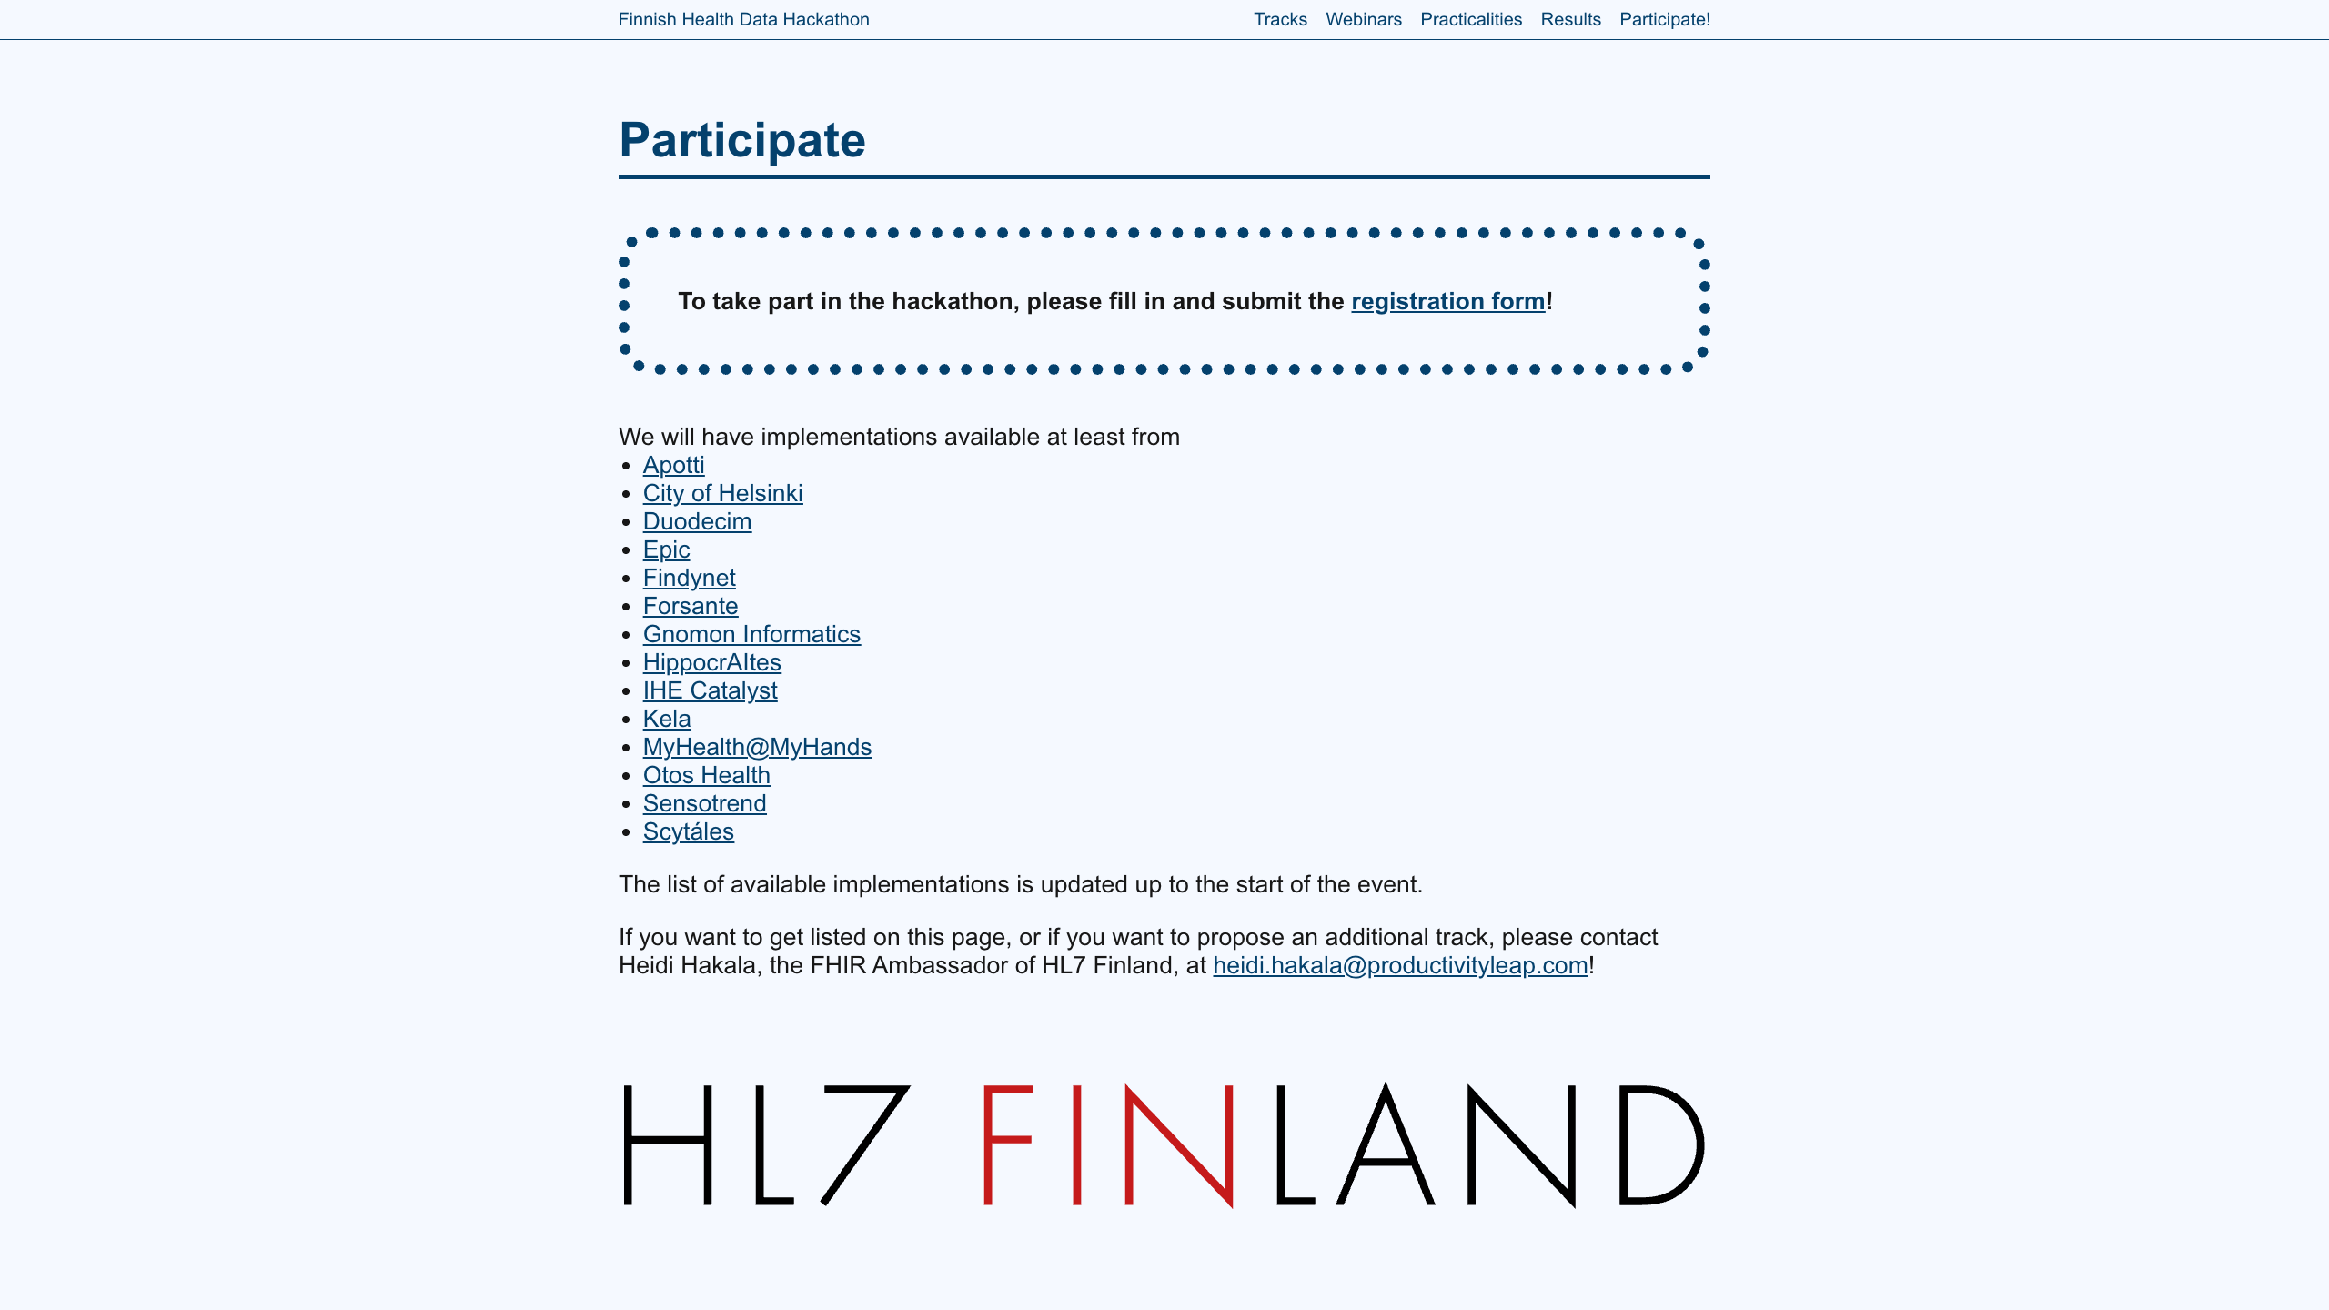

Slide 11
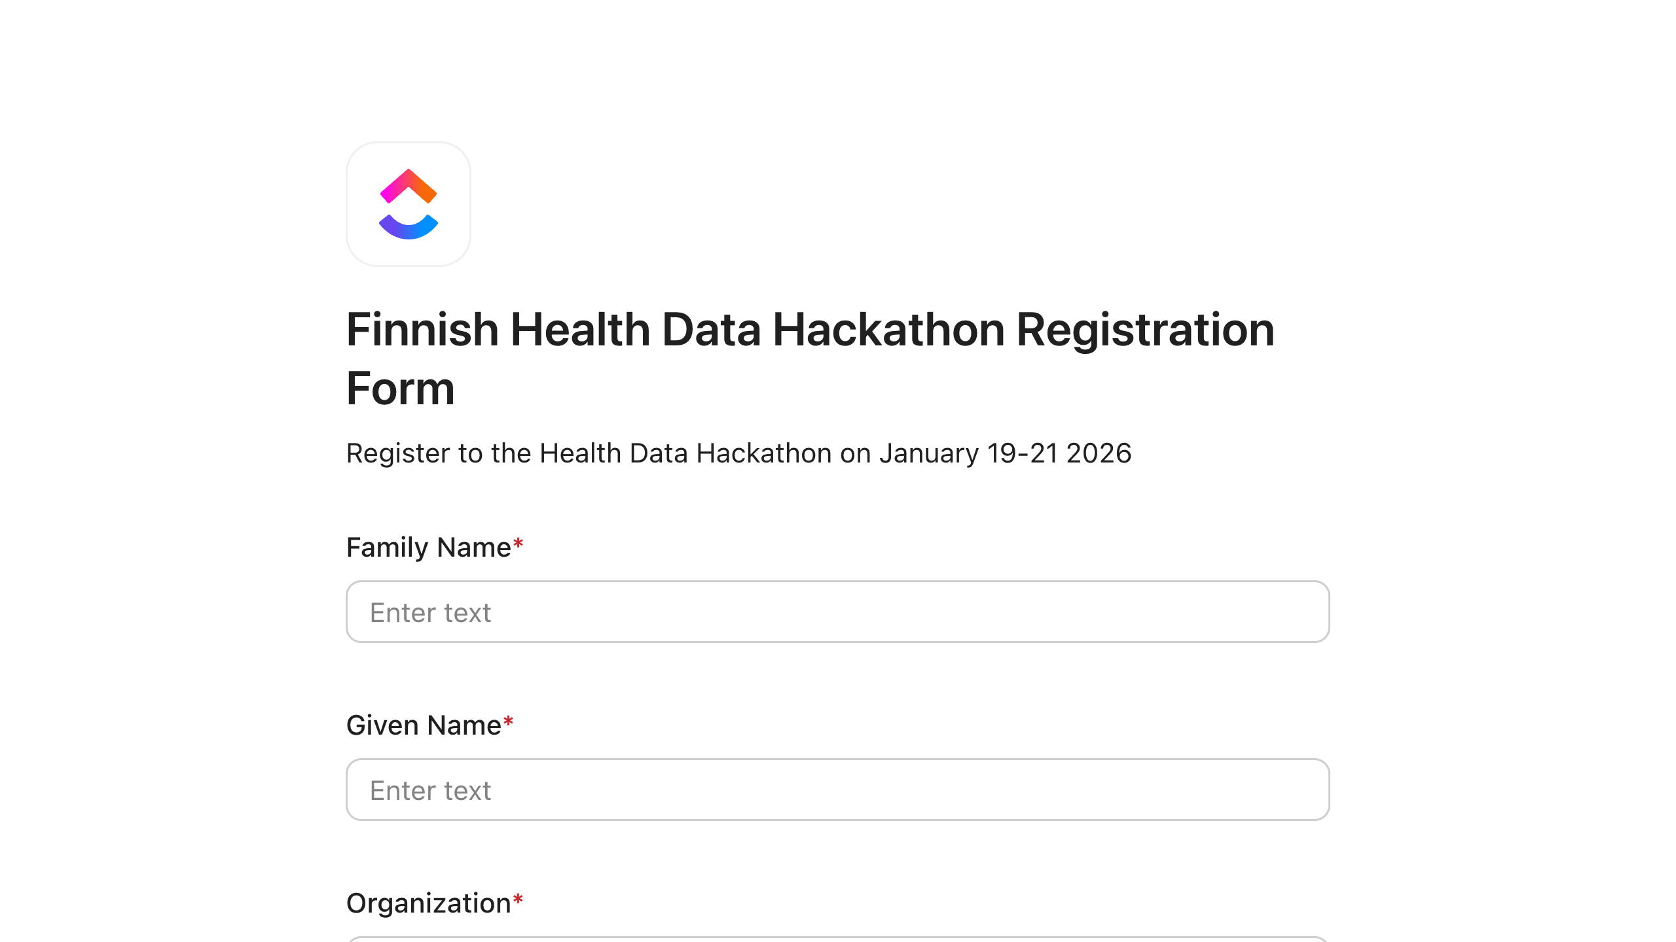

Slide 12
Care Plans and Clinical Reasoning
Finnish Health Data Hackathon 2026-01 Helsinki

Slide 13
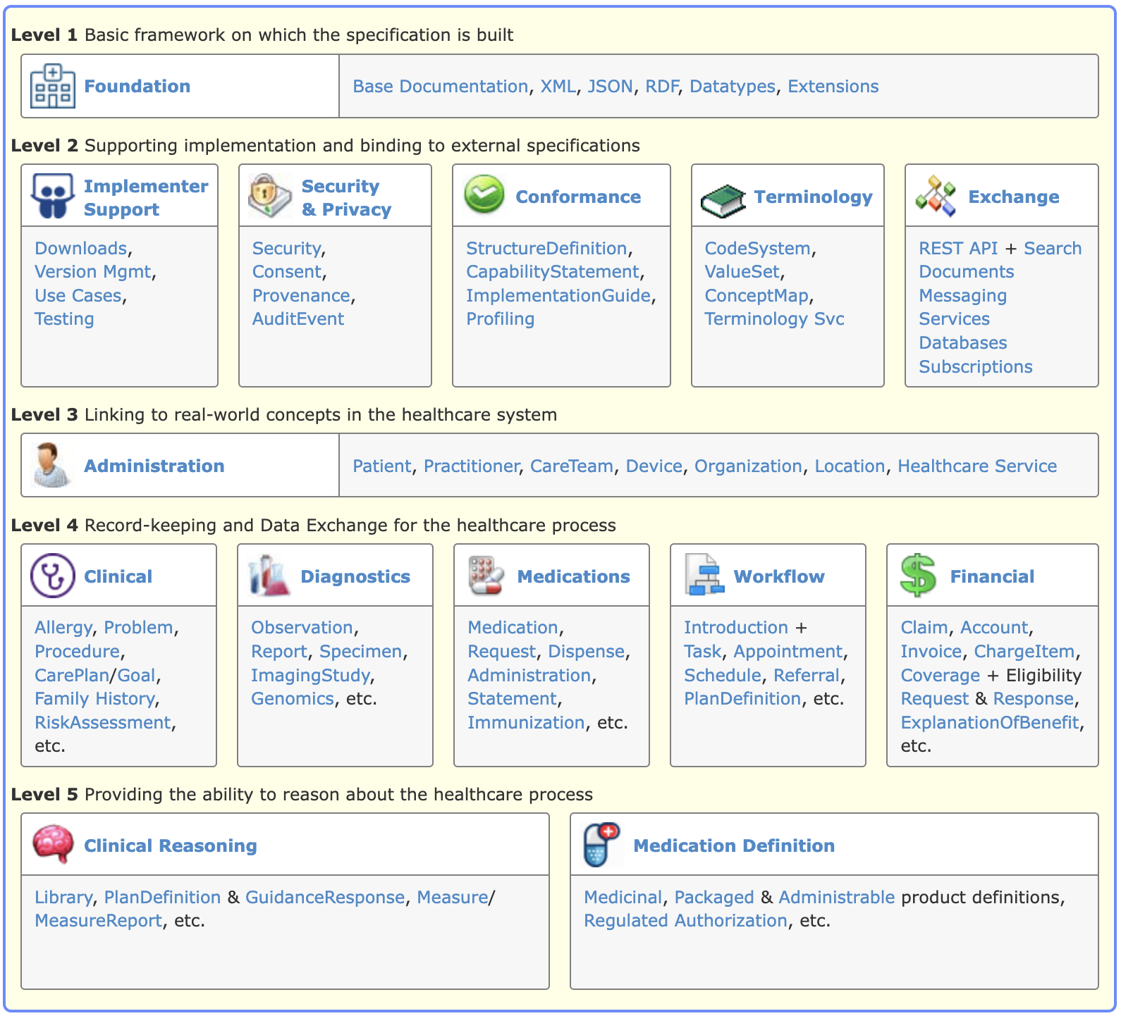
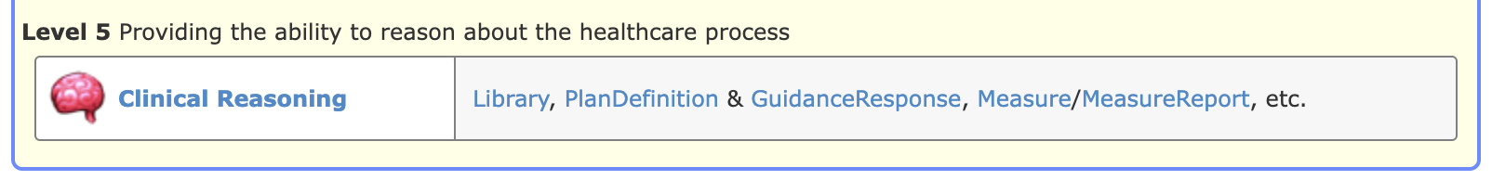
FHIR Clinical Reasoning
Level 5 of the FHIR specification:
The Clinical Reasoning Module https://hl7.org/fhir/R4/clinicalreasoning-module.html

Slide 14
Knowledge Artifacts – Use Case: Sharing
Representation of patient-independent clinical knowledge Sharing knowledge artifacts across systems and organizations
Decision support rules
Quality measures
Order sets
Clinical protocols
Care plans

Slide 15
Knowledge Artifacts – Use Case: Evaluation
Evaluate Knowledge Artifacts in the context of a patient or population Dynamic capabilities through expression languages
Example: Using dynamic values in Plan- and ActionDefinitions
Set field values
Encode applicability criteria

Slide 16
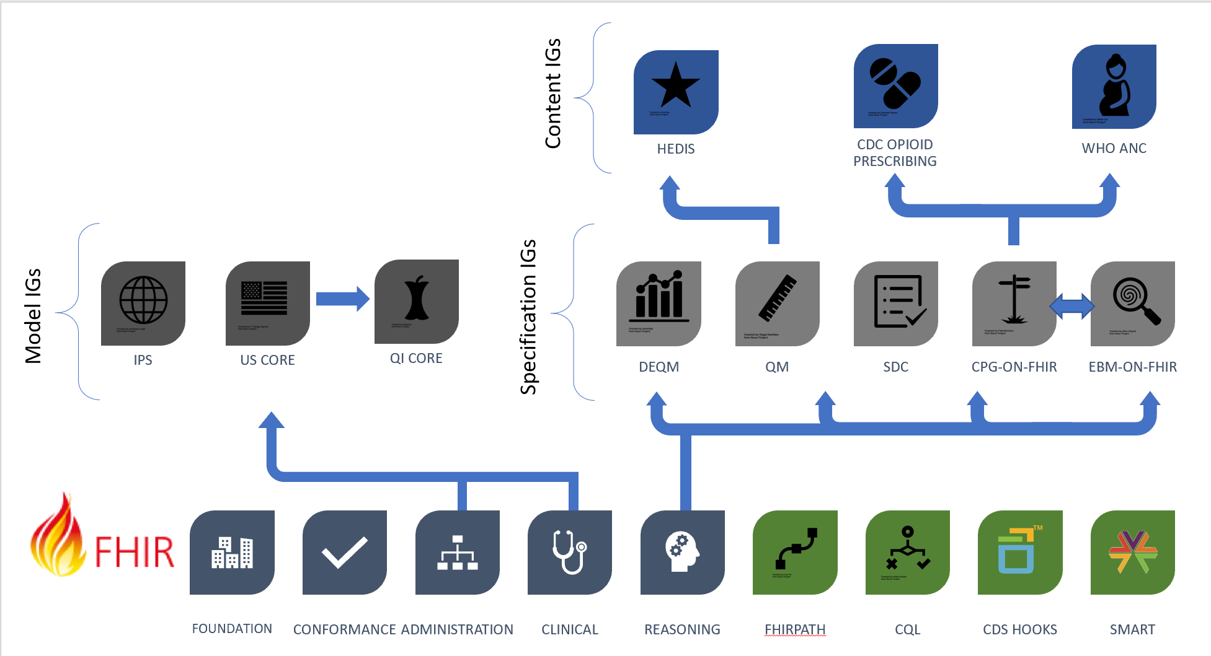
Publishing Knowledge Artifacts – IG Types
https://build.fhir.org/ig/HL7/cqf-recommendations/types-of-igs.png

Slide 17
CRMI – Canonical Resource Management Infrastructure
Defines profiles for (canonical) knowledge artifacts https://hl7.org/fhir/uv/crmi/STU1/
Shareable: requirements for sharing an artifact between systems (authoring, publishing, clinical implementation)
Computable: computable at authoring/design: how much the definition is computable, e.g. an intentional value set definition
Publishable: use context, publisher, copyright
Executable: implementation and runtime considerations (as opposed to authoring)

Slide 18
CRMI IG – Computable
Supports the authoring process Computable definition of the content “Computable” has different meaning for each resource type
ValueSet:
Intentional definition (compose)
Allows computable creation of the expansion
Library
CQL compiler options
Declaration of codes used by the Library

Slide 19
CRMI IG – Executable
Supports execution of the content The meaning of “Executable” for some resource type
ValueSet:
The expansion is present
Supports execution in environments that do not have a terminology service
Library
Dependencies
Parameters
Data requirements

Slide 20
CPG – Clinical Practice Guidelines
https://hl7.org/fhir/uv/cpg/STU2/
Methodology and profiles for the creation of computable representation of narrative clinical guidelines
Support creating computable representations that are faithful to the intent of the original narrative guidelines

Slide 21
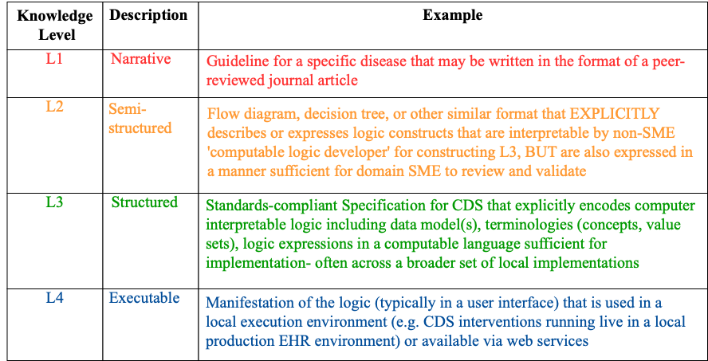
Knowledge representation levels
https://hl7.org/fhir/uv/cpg/STU2/knowledge-levels.png

Slide 22
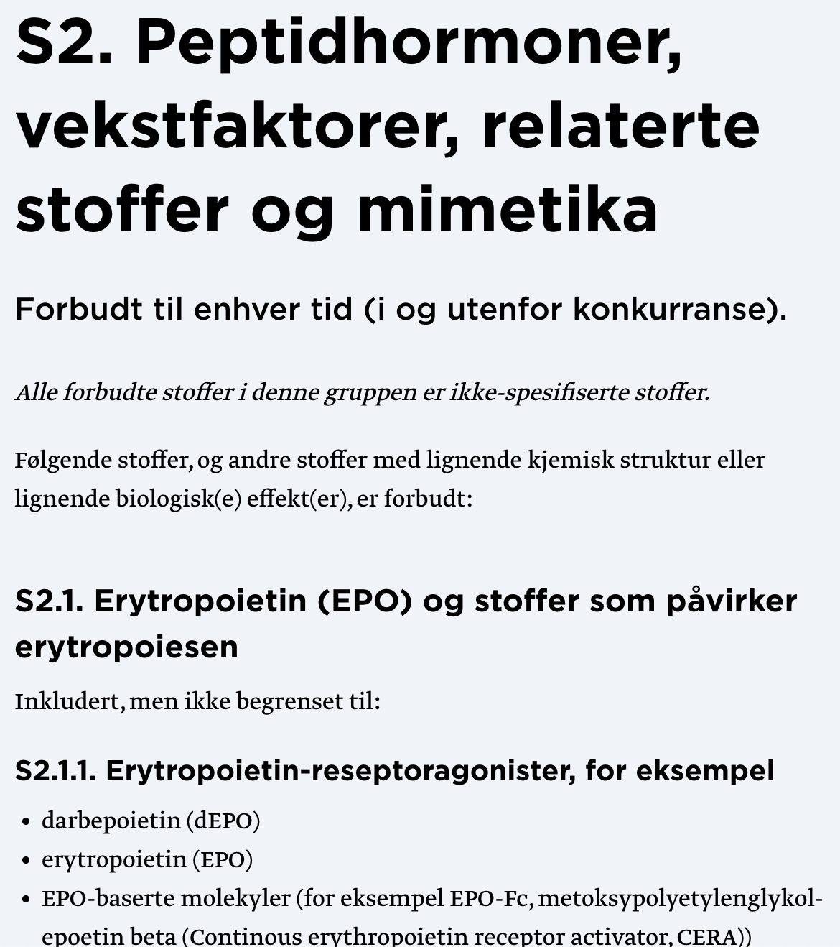
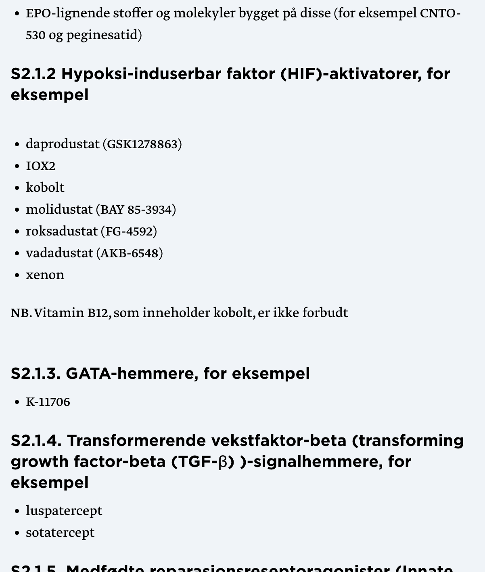
Clinical Guideline Example – The WADA List
Level 1 knowledge representation: Narrative

Slide 23
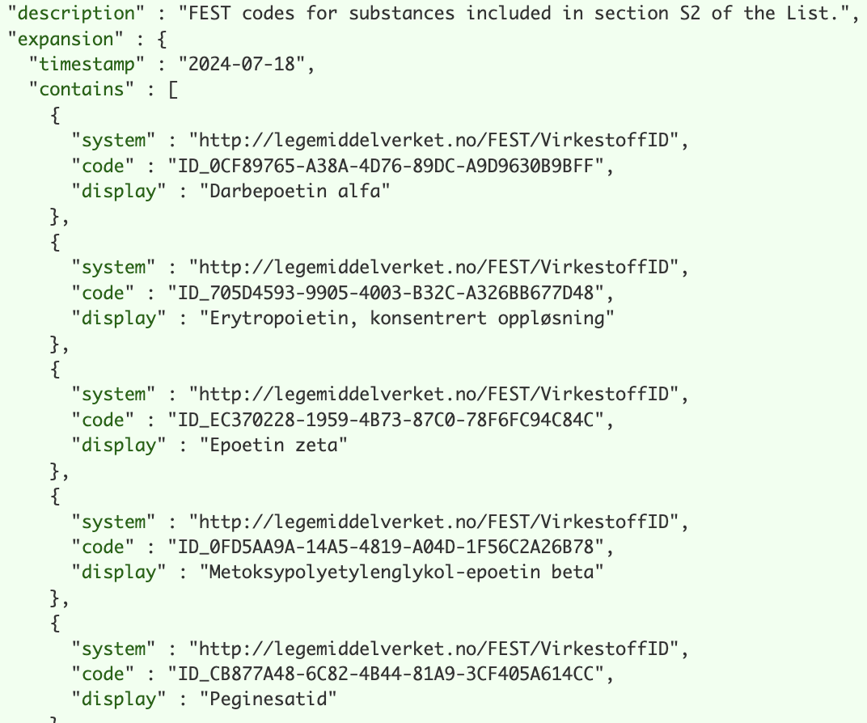
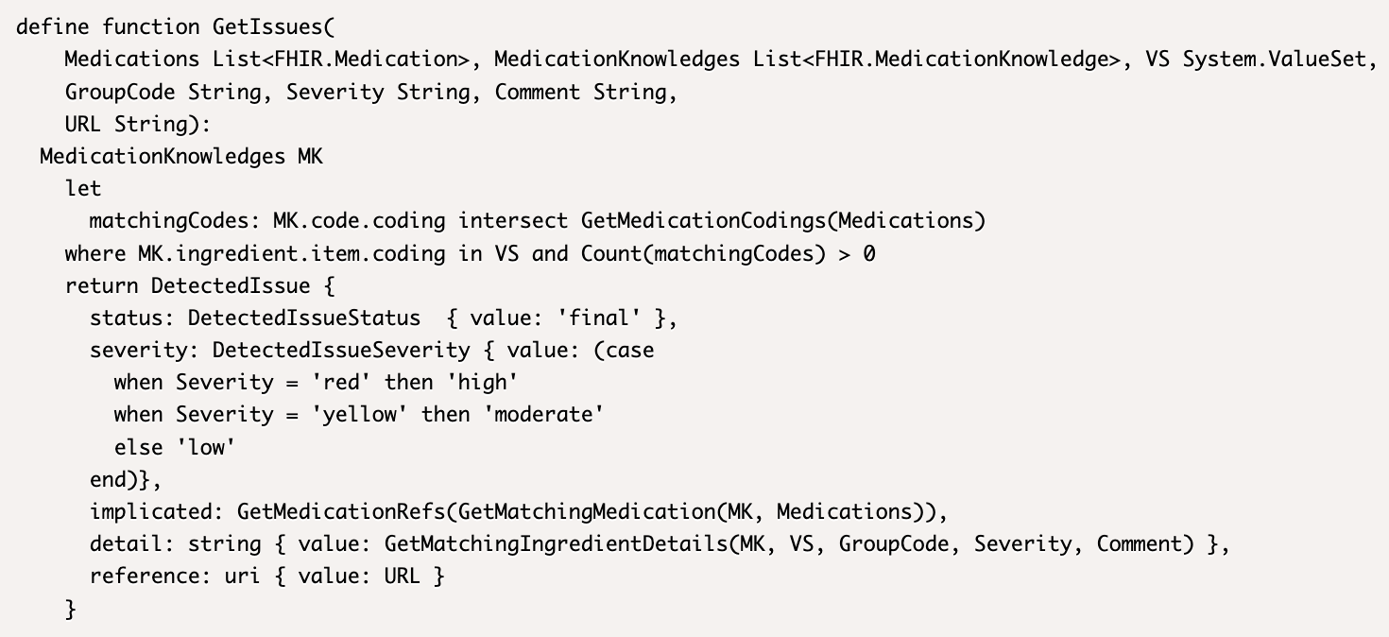
Clinical Guideline Example – The WADA List
POC L3 (Structured) representation using FHIR and CQL Published as a Content Implementation Guide
https://build.fhir.org/ig/adamzkover/wada-list-fhir/index.html

Slide 24
Clinical Guideline Example – The WADA List
L4 (Executable) representation:
Load the IG’s artifacts into a compatible FHIR server (e.g. HAPI FHIR starter)
Load medication data e.g. from FEST (terminology must match the IG)
Send a request to the Library $evaluate operation

Slide 25
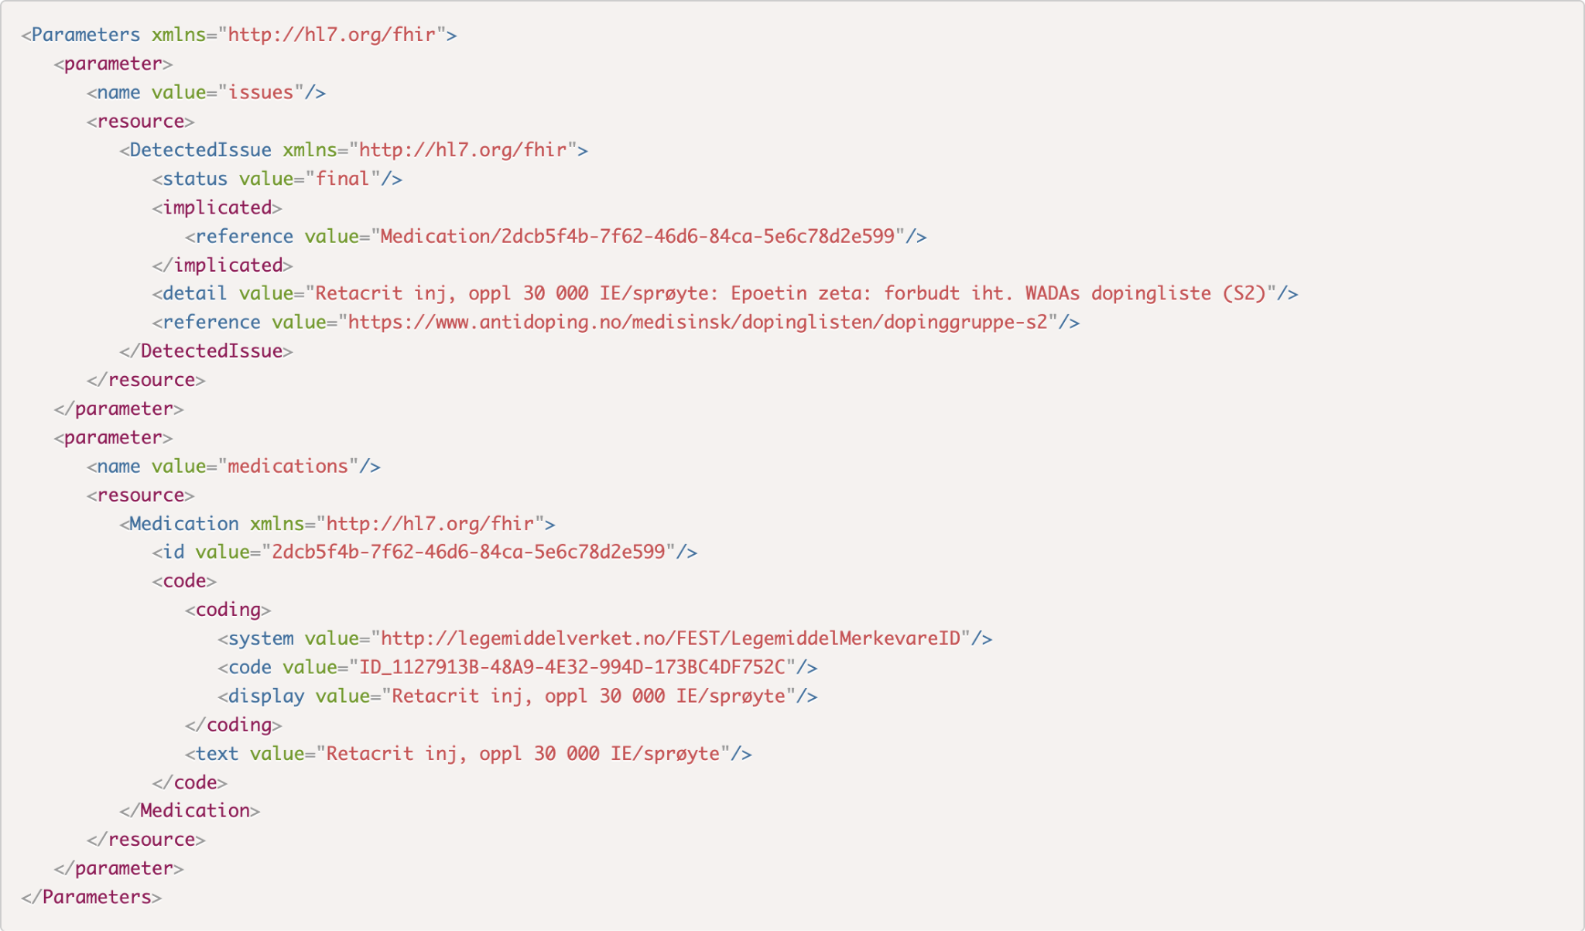
Clinical Guideline Example – The WADA List

Slide 26
Evidence Based Medicine (EBM) on FHIR
Profiles and terminology for the representation of scientific knowledge and research, articles and studies
Share information about research in FHIR format
Evaluate eligibility criteria for research studies
Find research relevant to a specific patient context

Slide 27
CDS Hooks
An HL7 standard for workflow-based decision support https://cds-hooks.hl7.org/
Shared understanding of workflow steps between client and server
Different relevant data (context) at each step
Decision Support Hook
Decision Support Hook
Decision Support Hook
Decision Support Hook
Book appointment
Start appointment
Add to problem list
Prescribe medication

Slide 28
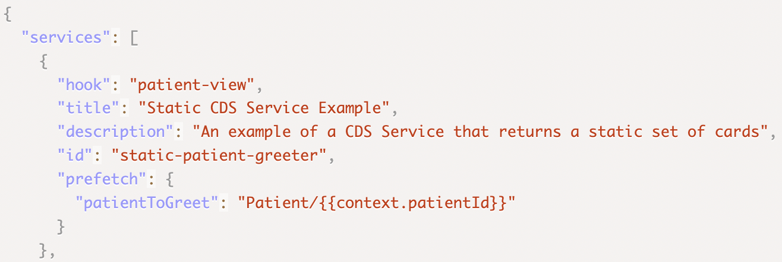
CDS Hooks – API Definition – Discovery
Standard API endpoint for listing the services (functions) provided by a decision support service
Each service declares
Identity
Appropriate workflow step (hook)
Description of the service and the use context
Data requirements

Slide 29
CDS Hooks – API Definition – Requests
JSON structure for the invocation of a CDS Hooks service, including:
Service, hook, and invocation ID
FHIR server access
Server URL
Authorization token
Required input data
Hook-specific context (e.g. medication for order-select)
Prefetch (service-specific)

Slide 30
CDS Hooks – API Definition – Response
Central concepts: Card, Action, Suggestion
Card
Summary
Detail
Indicator (severity)
Source (reference)
Suggestions (actions)
Actions (CRUD request type, resource, description)
Links (to launch SMART on FHIR apps, not the same as Source)
Feedback

Slide 31
CDS Hooks – Hook Library
Attached to the CDS Hooks specification
Hooks may be proposed by the community, and are matured according to the standard HL7 process
Mature hook examples:
patient-view
order-select
order-sign

Slide 32
CQL – Clinical Query Quality Language
https://cql.hl7.org/
A domain-specific language for quality measure and decision support
Independent of the data model
Can be used with any data model, including FHIR
Reference implementations (execution engines) available HAPI, Firely…
Embedded in Library resources in FHIR implementations

Slide 33
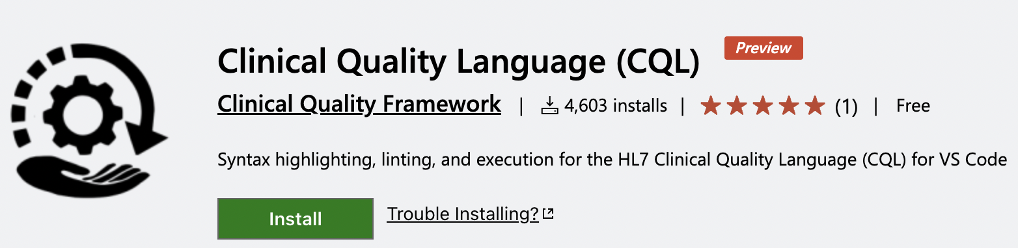
CQL – Development and Testing
VS Code plugin
User Guide: https://github.com/cqframework/vscode-cql/wiki/User-Guide
Directory structure
Naming conventions

Slide 34
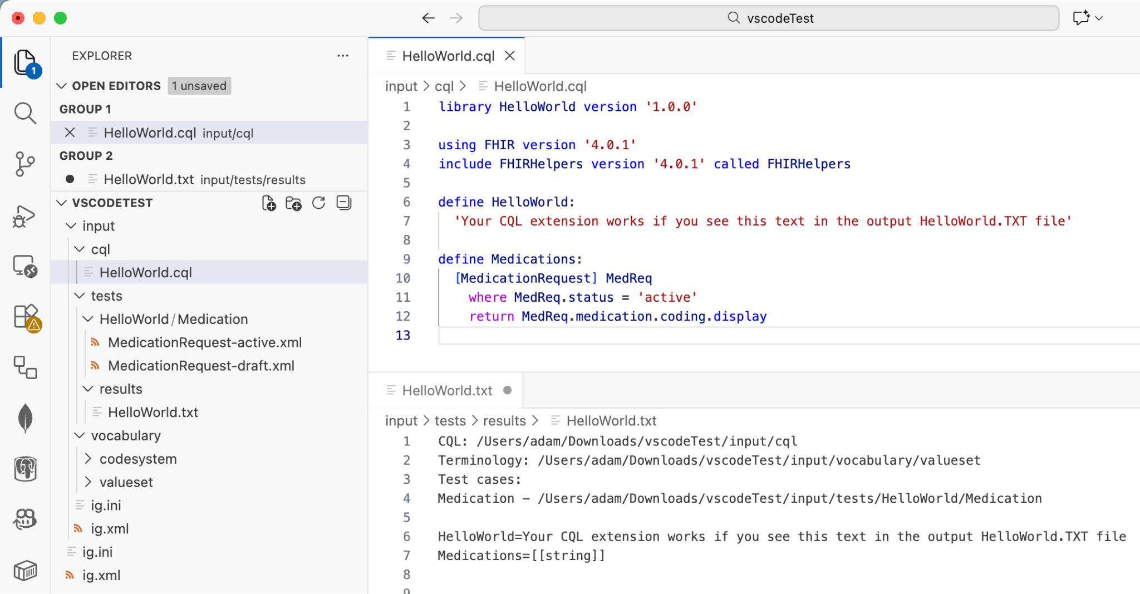
CQL Execution – Demo

Slide 35
Example Topics for: Care Plans and Clinical Reasoning
Finnish Health Data Hackathon 2026-01 Helsinki

Slide 36
Authoring, Publishing, and Sharing Clinical Knowledge
Example Topic:

Slide 37
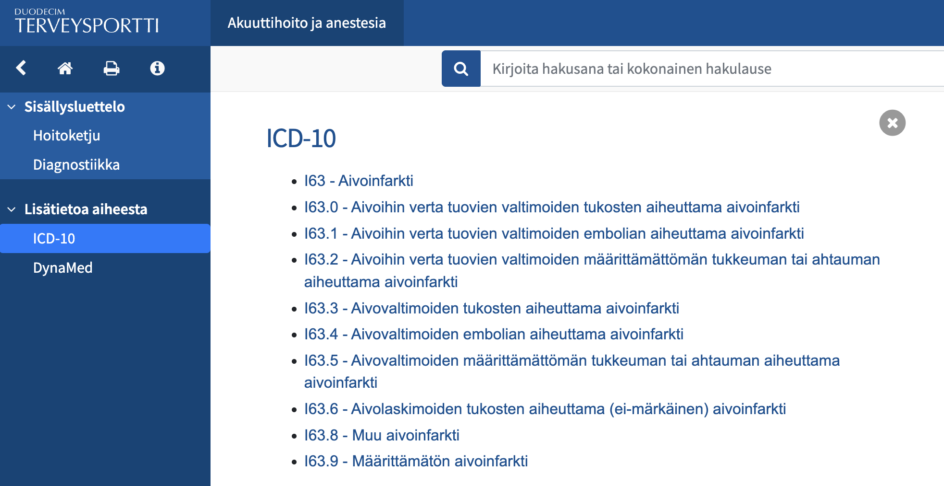

Slide 38
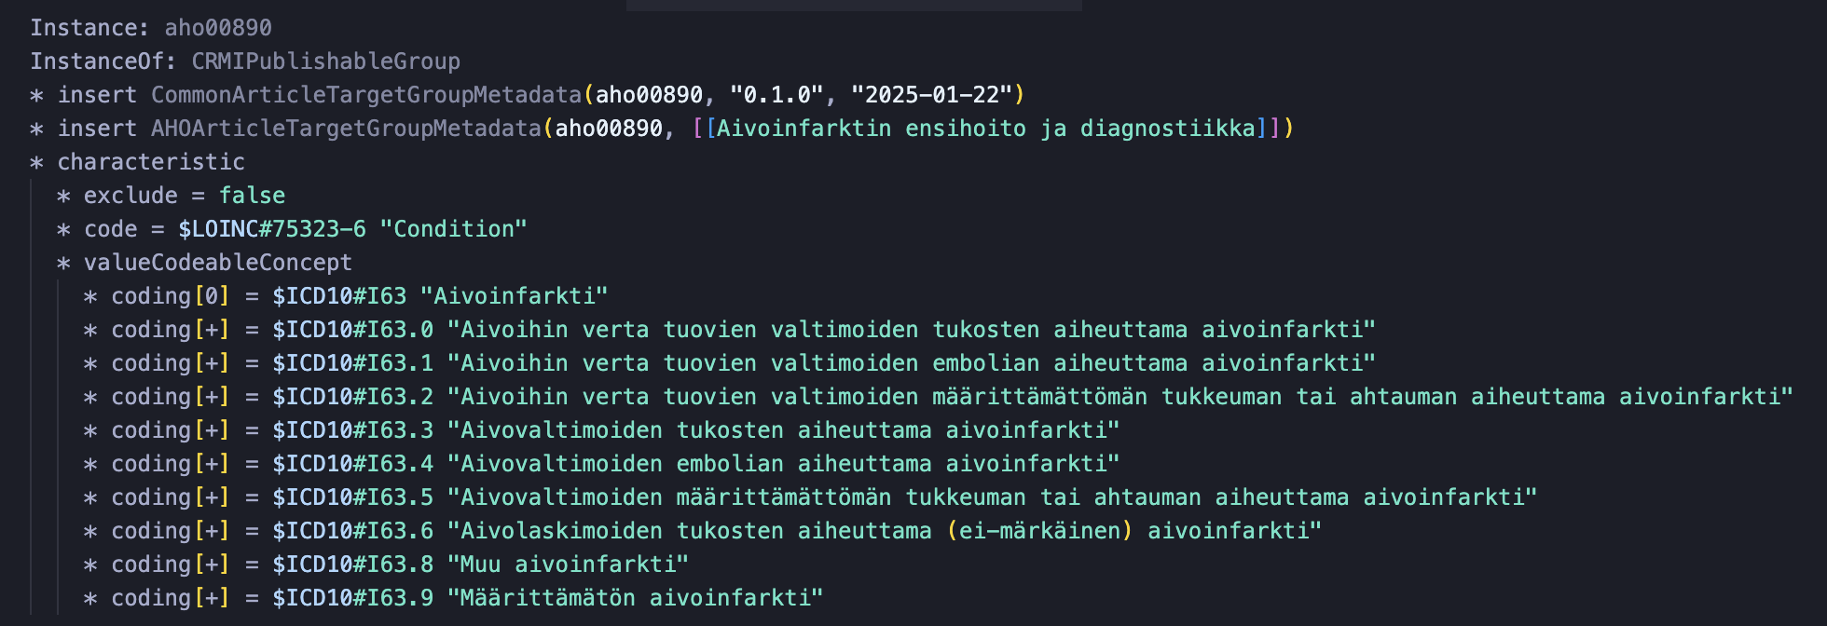

Slide 39
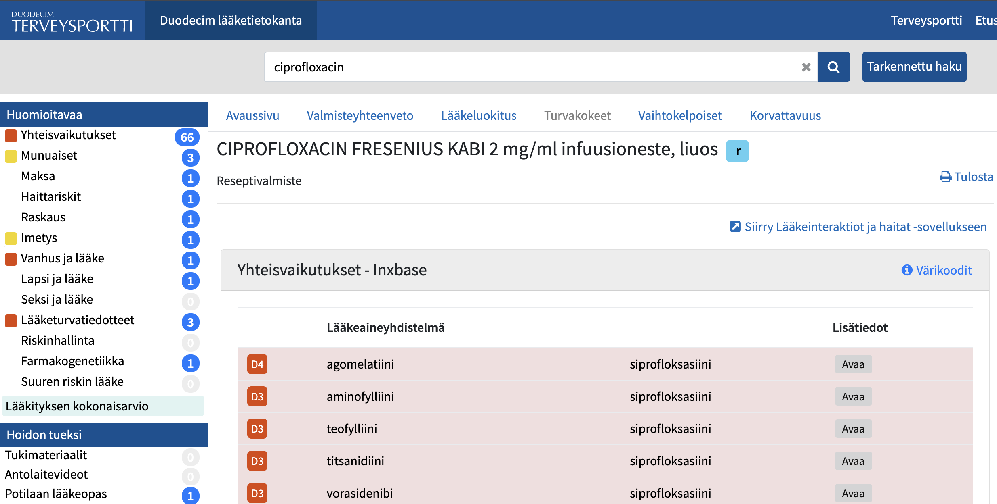

Slide 40
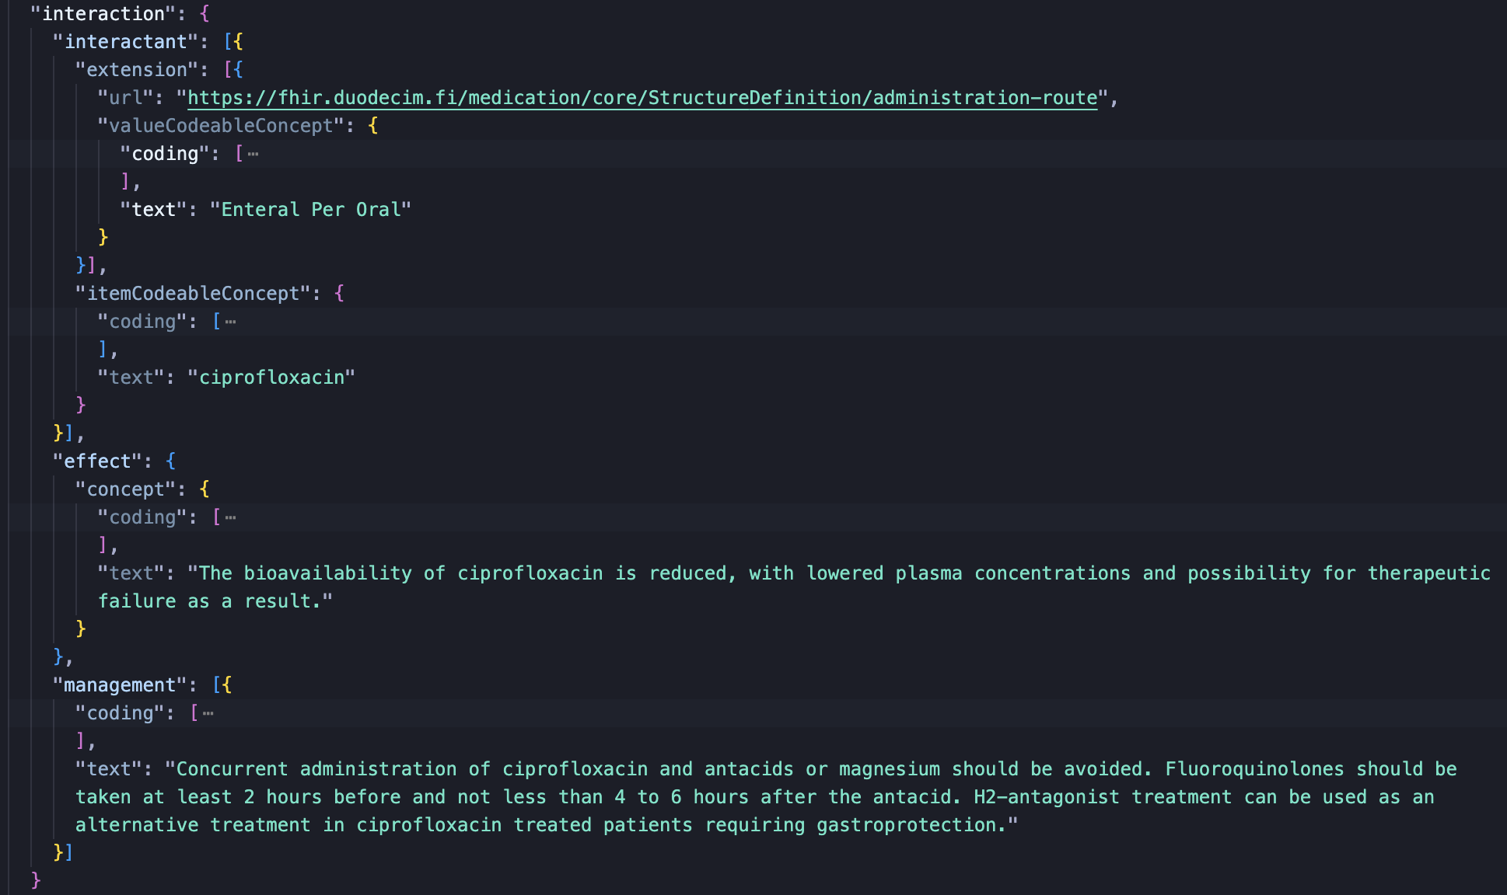

Slide 41
Tooling is still mostly for IGs, here’s SUSHI with ~20K instances:
55498 ttys003 438:32.93 node /Users/joonatan/.nvm/versions/node/v20.13.1/bin/sushi

Slide 42
Defining Clinical Concepts
Example Topic:

Slide 43
ValueSet Compose Language (VCL)
B-Hb http://fhir.org/VCL?v1=(http://loinc.org)ancestor=LP392452-1
Aspirin http://fhir.org/VCL?v1=(http://www.nlm.nih.gov/research/umls/rxnorm)has_ingredient=1191
Nitrates http://fhir.org/VCL?v1=(http://www.whocc.no/atc)concept<<C01D
Asthma http://fhir.org/VCL?v1=(http://snomed.info/sct)concept<<195967001

Slide 44
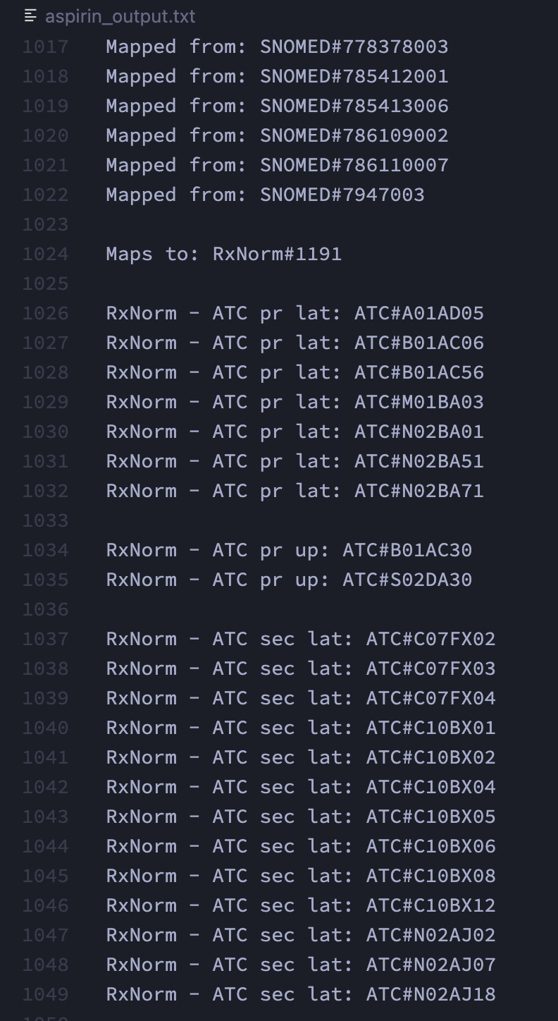
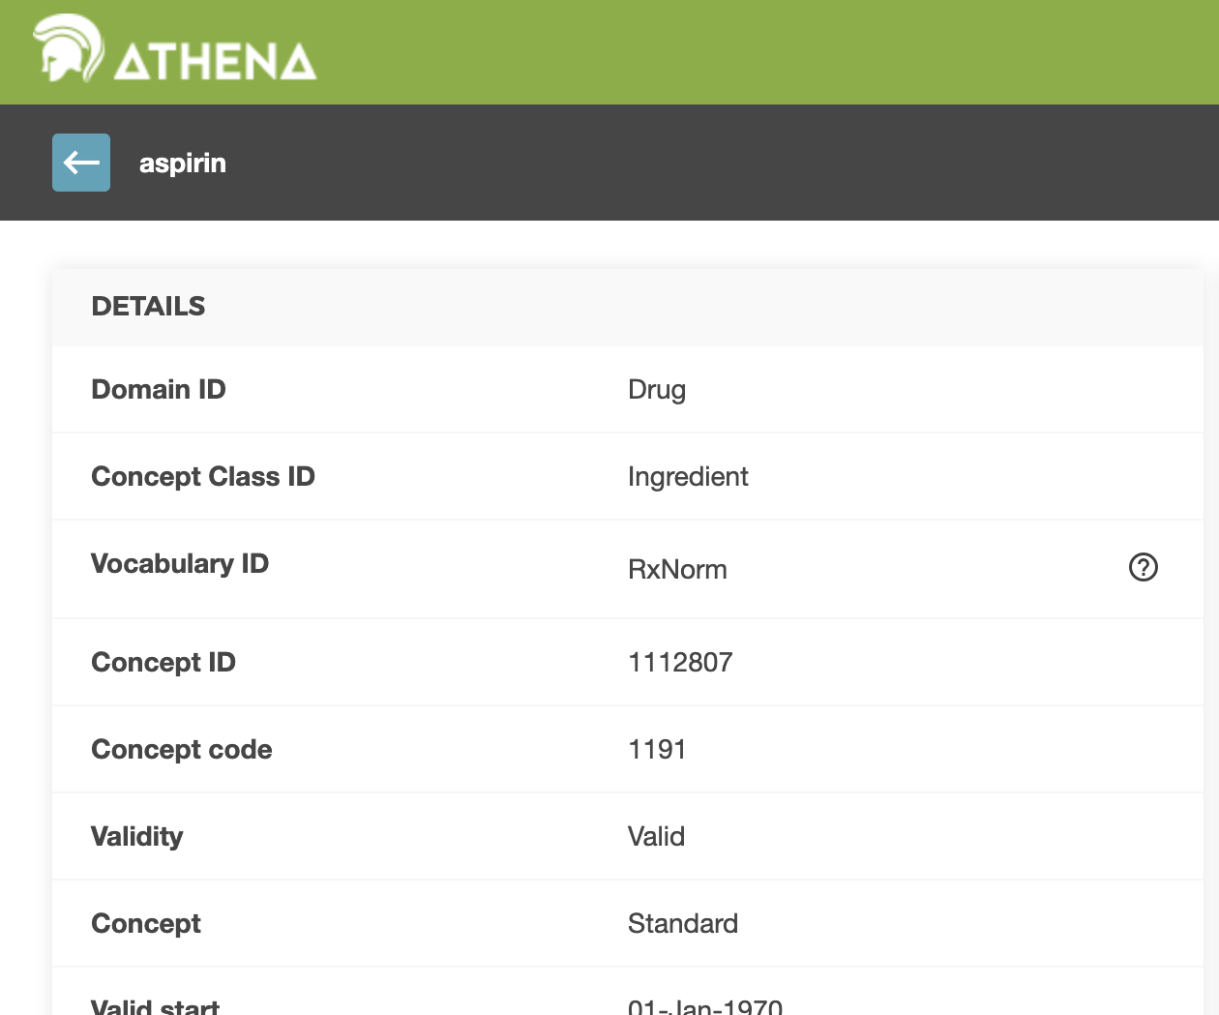

Slide 45
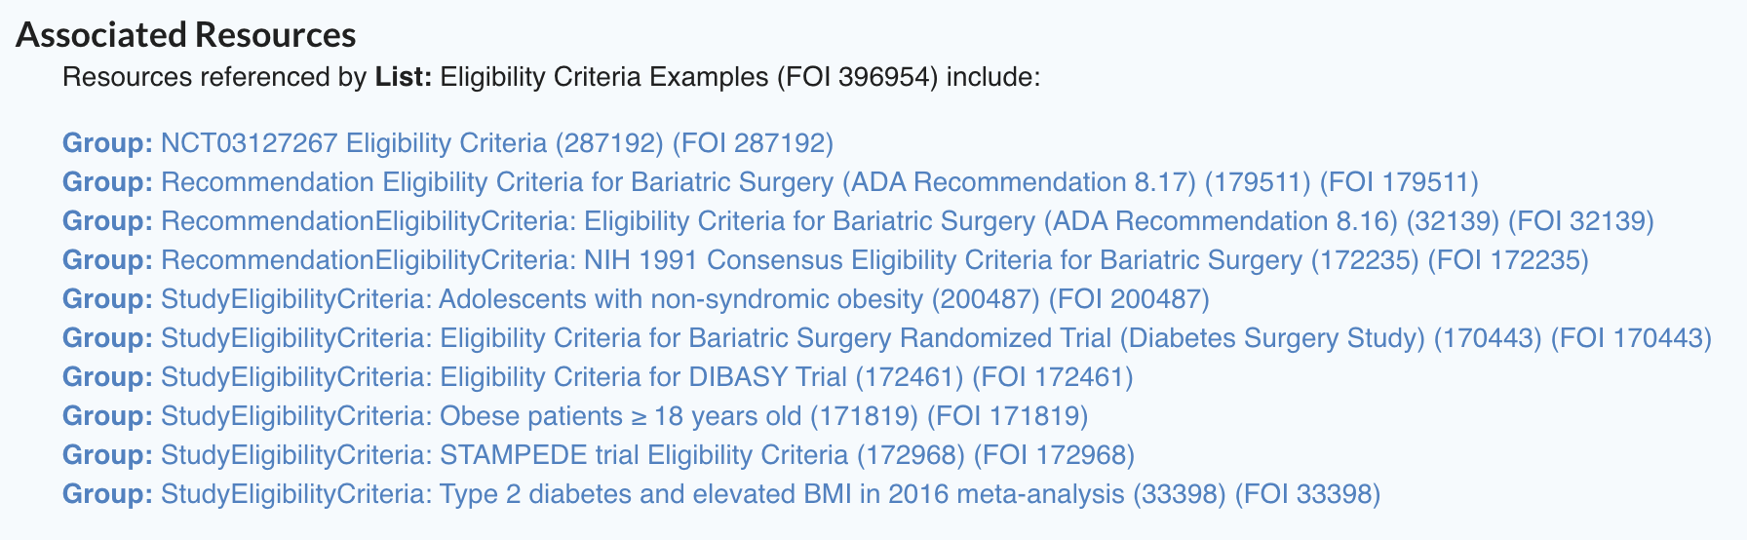
FEvIR CohortDefinition Examples
https://fevir.net/resources/List/396954

Slide 46
See the following comments on the CRMI IG repository for our initial suggestions on using CohortDefinition as a shared model:
https://github.com/HL7/crmi-ig/pull/95#issuecomment-3442231452

Slide 47
Modelling Care Plans and Computable Guidelines
Example Topic:

Slide 48
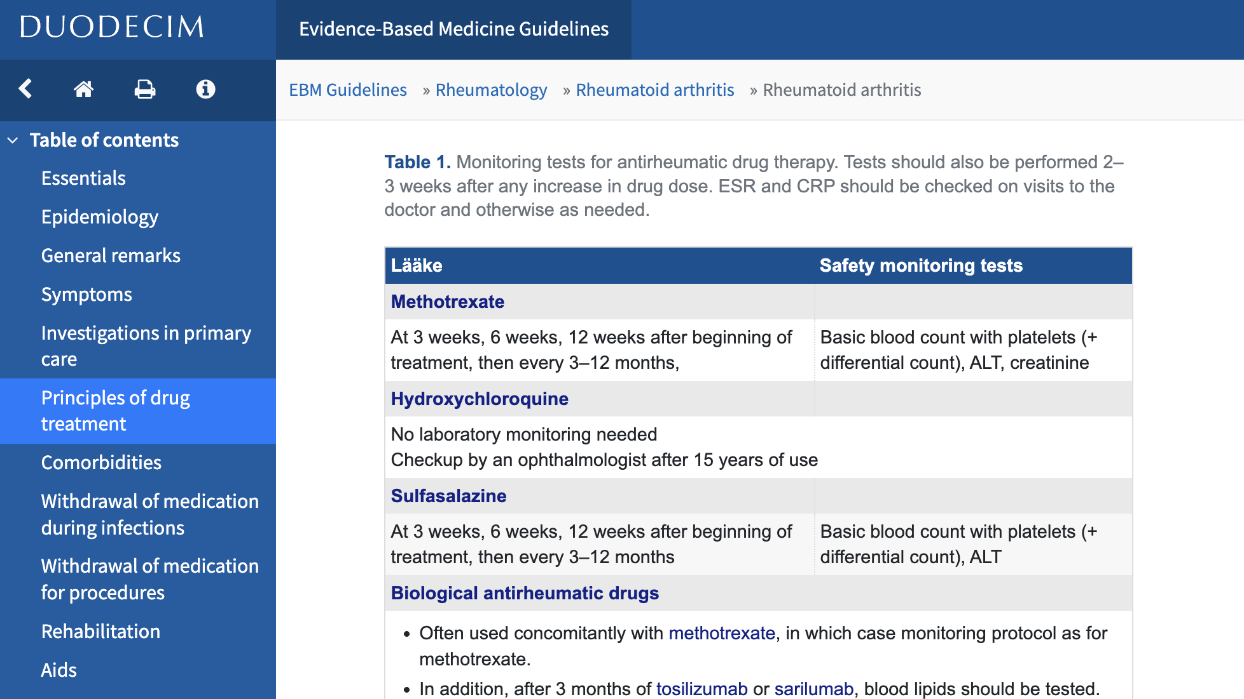

Slide 49
Example L4 slice from Duodecim EBMG RA guideline is available:
https://github.com/reason-healthcare/interactive-cds-content

Slide 50
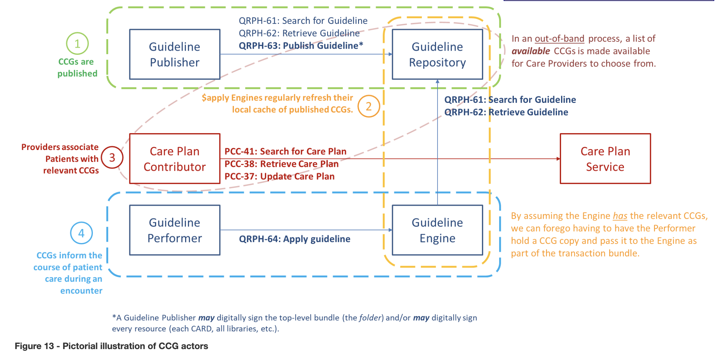
IHE Computable Care Guidelines (CCG)

Slide 51
Testing Clinical Knowledge Against European Synthetic Data
Example Topic:

Slide 52
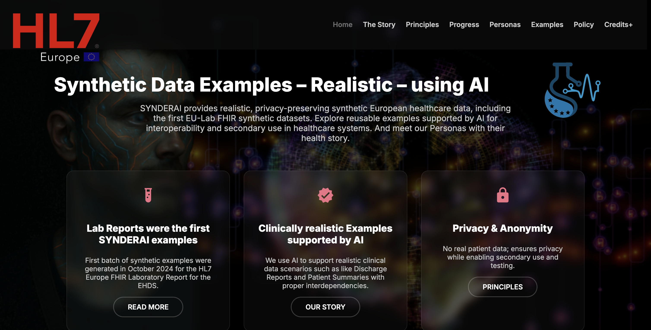

Slide 53
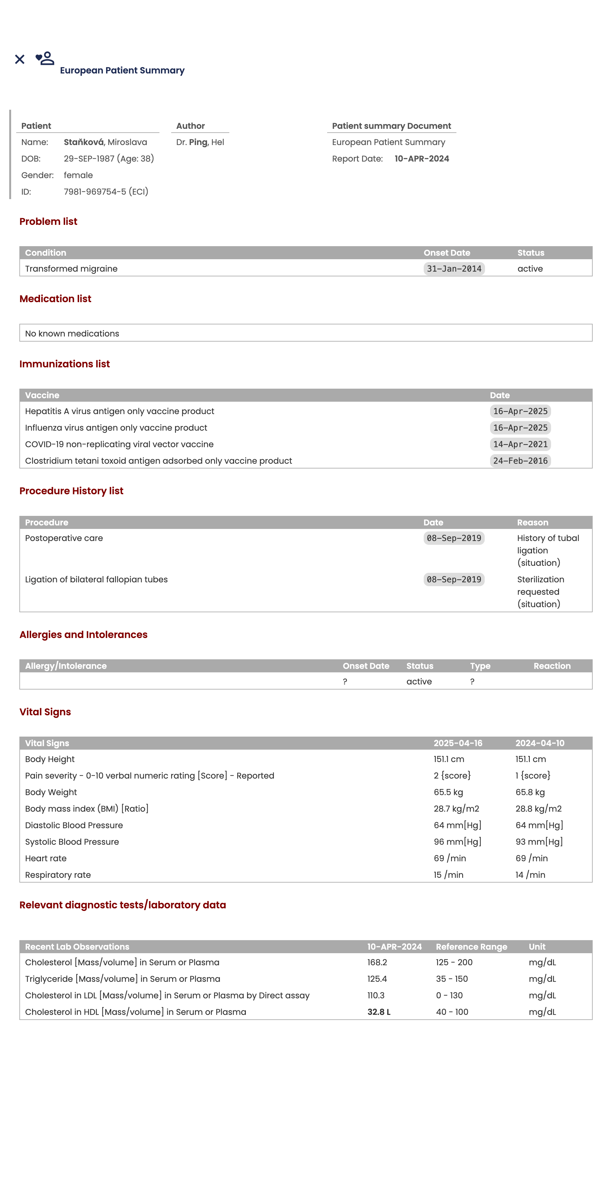
European Patient Summary
Condition
AllergyIntolerance
MedicationStatement
Observation
Immunization
Procedure
Observation

Slide 54
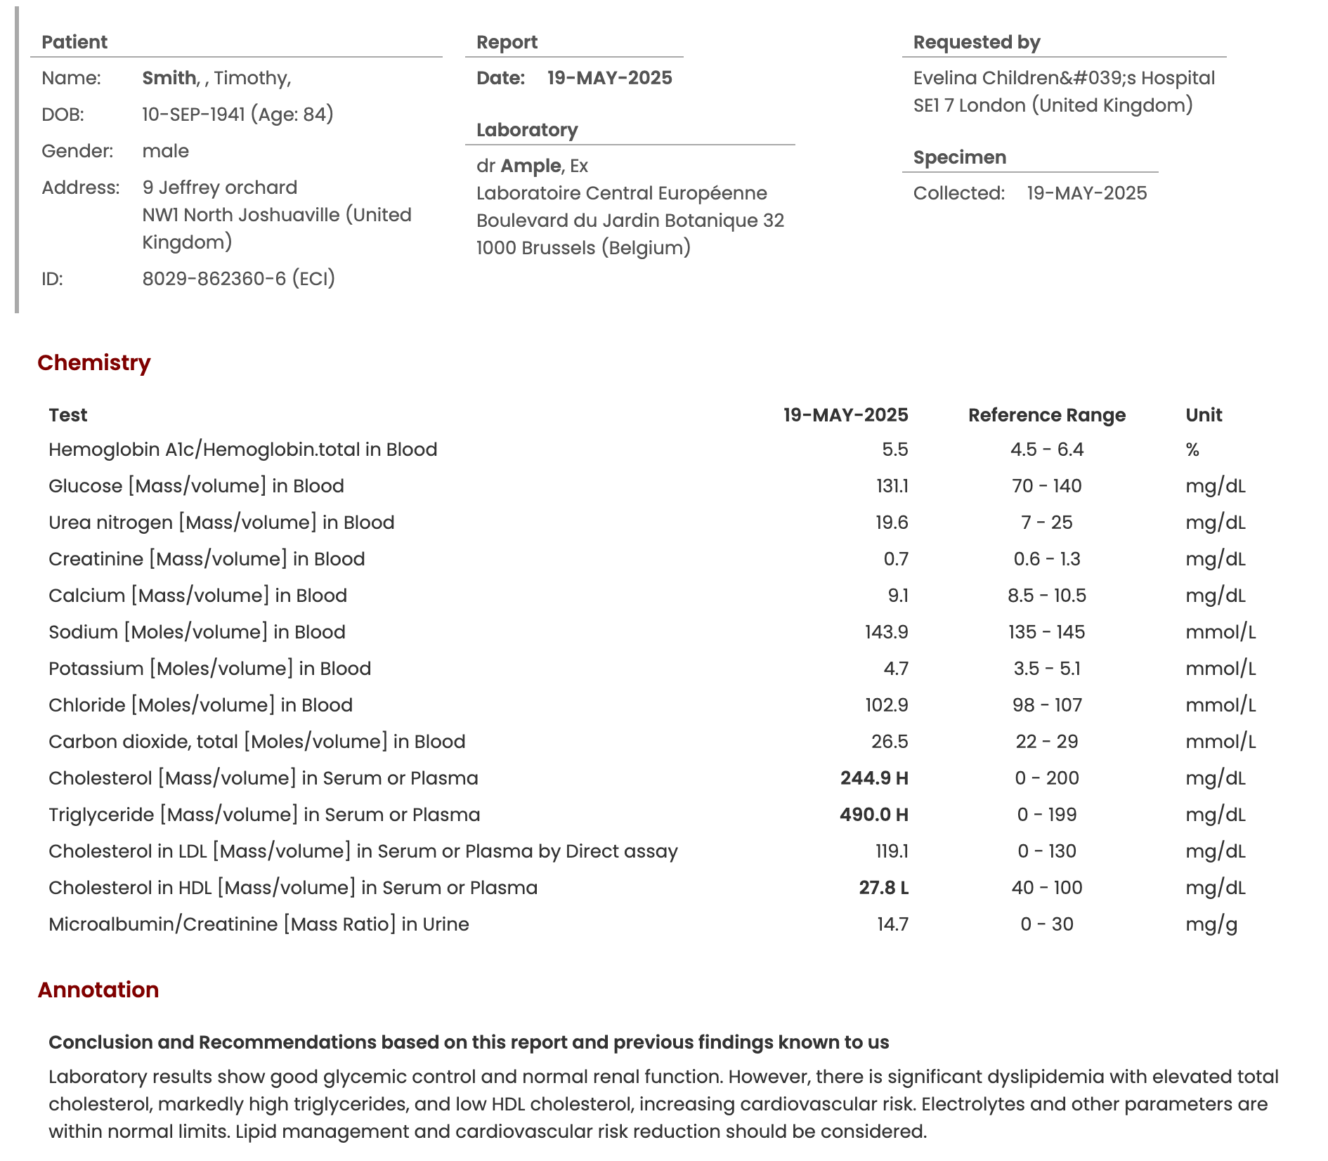
European Laboratory Report
Observation

Slide 55
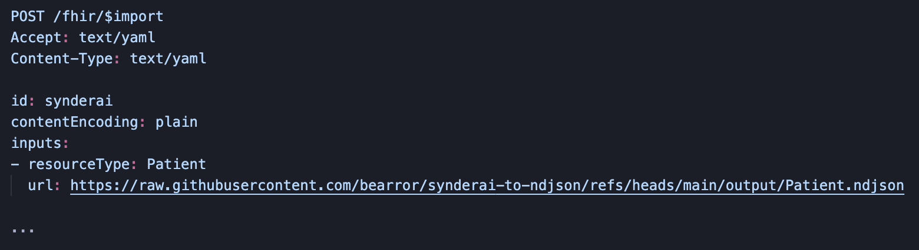
Example extractor: https://github.com/bearror/synderai-to-ndjson

Slide 56
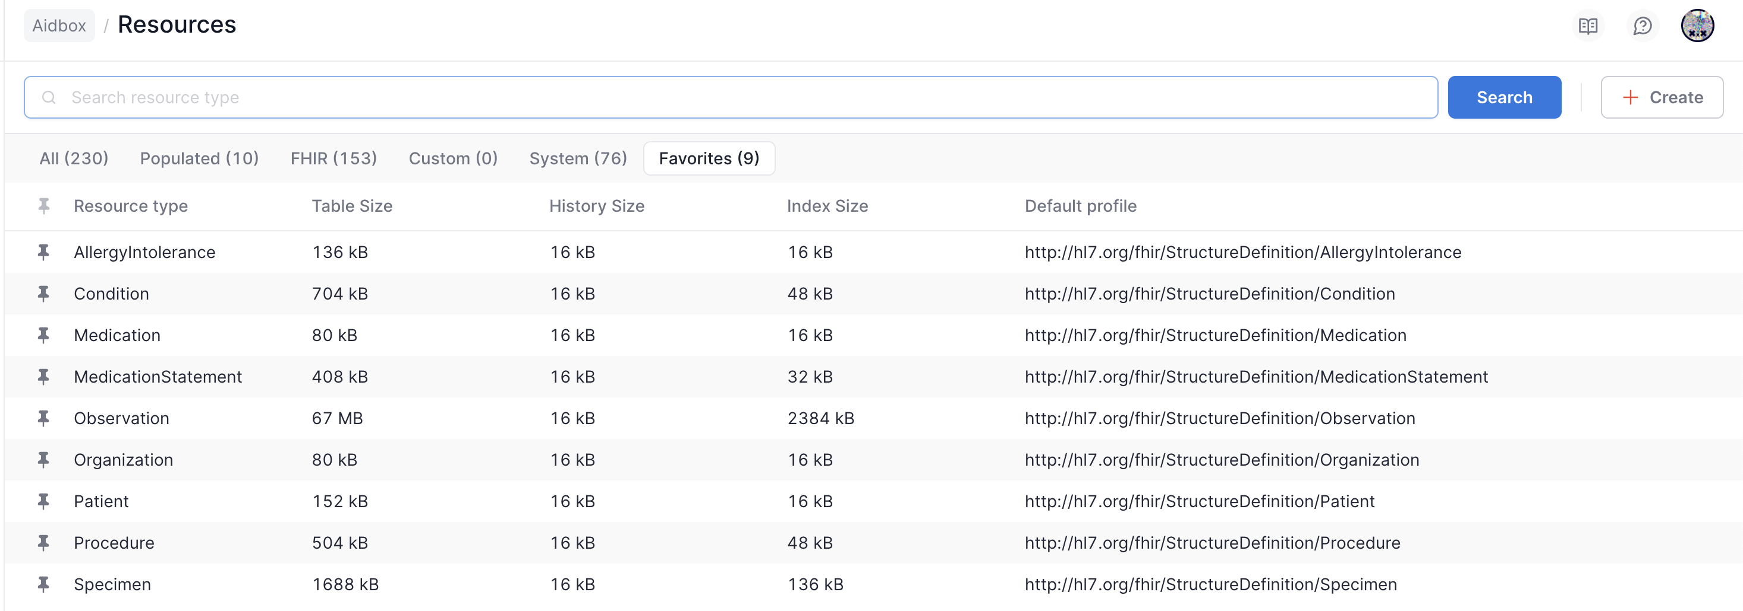

Slide 57
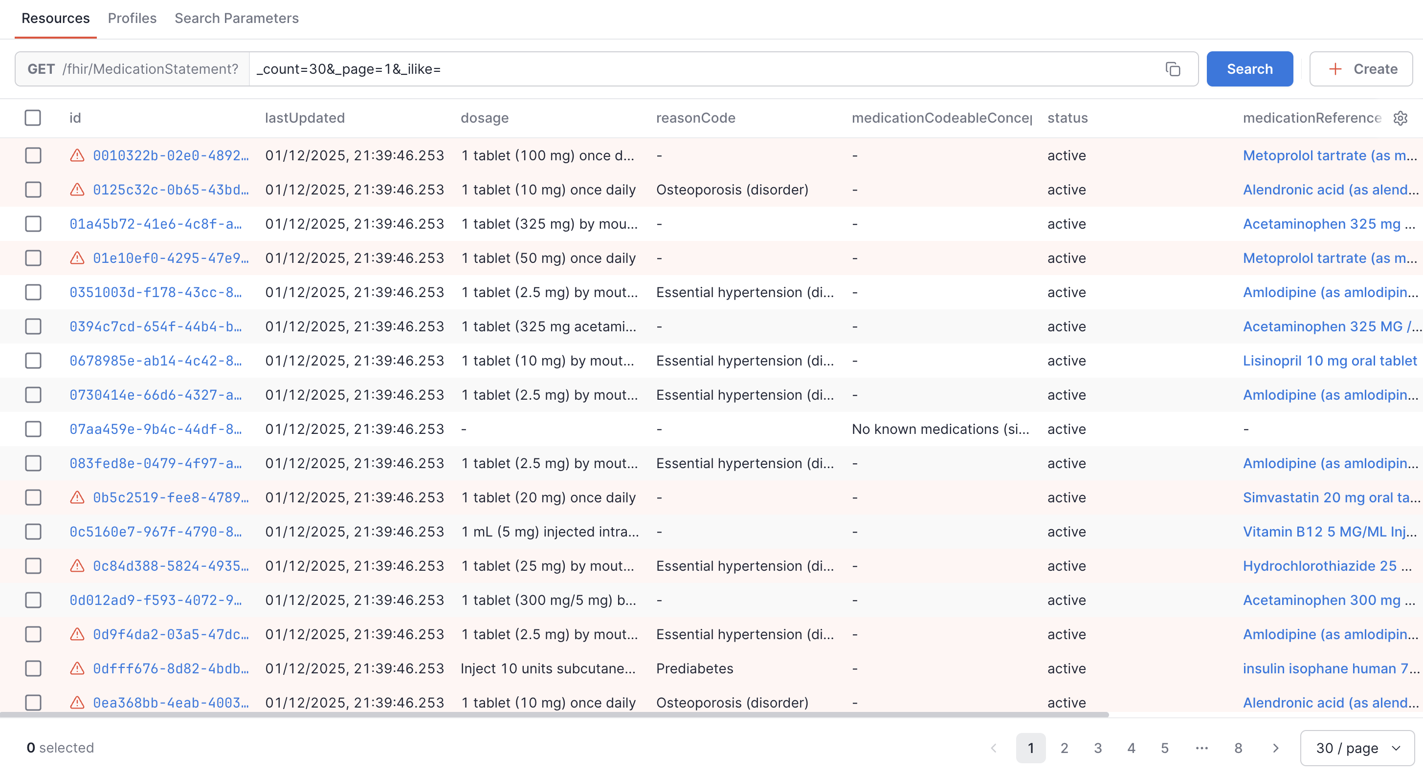

Slide 58
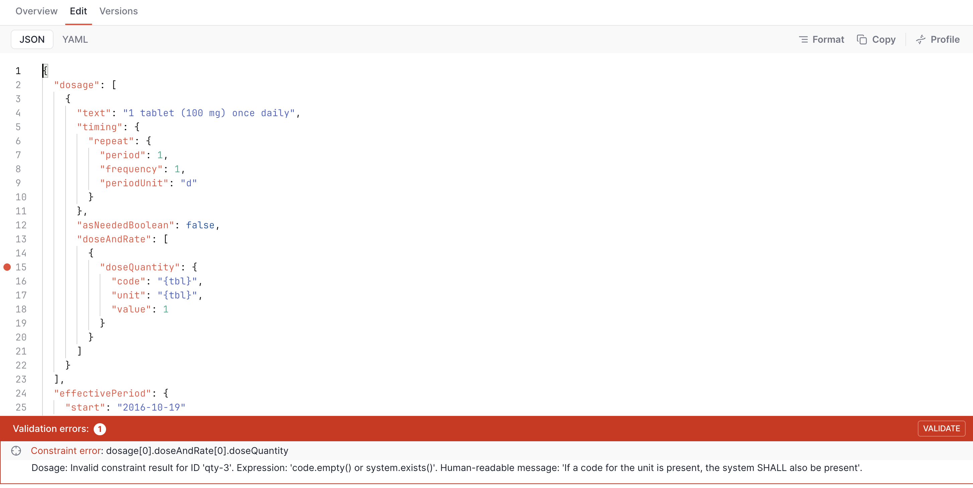

Slide 59
Integrating Clinical Knowledge
Example Topic:

Slide 60
Example integrations Duodecim has ready…
Direct: Duodecim can provide an example CRMI medication knowledge base with ClinicalUseDefinition resources
Reasoning-as-a-Service: Duodecim can provide the same medication knowledge base as a CDS Hooks service on order-select
In addition, Duodecim could start moving the questionnaire-completed hook towards standardisation, if there’s interest

Slide 61
Participating on the Care Plan & Clinical Reasoning Track
Fill in the Google Sheet at https://docs.google.com/spreadsheets/d/1X6WD6GPxNvwwpRAb0gsIti_5LBTuGT5nnwUk535piCQ/edit?usp=sharing
Share your ideas and interests!

Slide 62
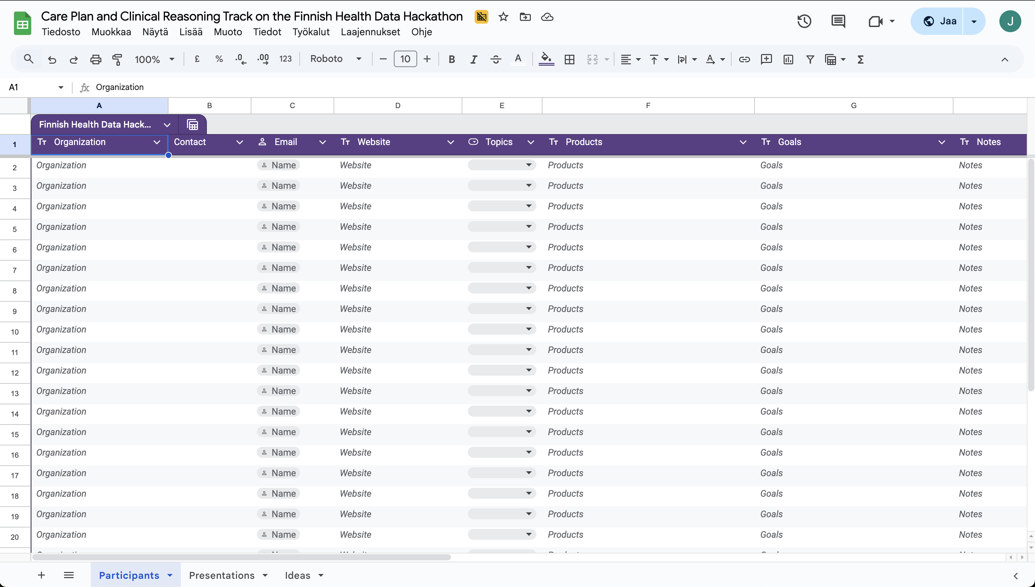

Slide 63
Q&A
Care Plan & Clinical Reasoning Track of the Finnish Health Data Hackathon

Slide 64
Sponsors

Slide 65
Next Webinars
Wallets, national contact points (NCP)
Friday, December 19, 11:00 CET

Slide 66
Thank you for participating!

